Slide 1
Mark 14:26-52

Slide 2
²⁶ And when they had sung a hymn, they went out to the Mount of Olives. ²⁷ And Jesus said to them, “You will all fall away, for it is written, ‘I will strike the shepherd, and the sheep will be scattered.’ ²⁸ But after I am raised up, I will go before you to Galilee.” ²⁹ Peter said to him, “Even though they all fall away, I will not.” ³⁰ And Jesus said to him, “Truly, I tell you, this very night, before the rooster crows twice, you will deny me three times.” ³¹ But he said emphatically, “If I must die with you, I will not deny you.” And they all said the same.

Slide 3
³² And they went to a place called Gethsemane. And he said to his disciples, “Sit here while I pray.” ³³ And he took with him Peter and James and John, and began to be greatly distressed and troubled. ³⁴ And he said to them, “My soul is very sorrowful, even to death. Remain here and watch.” ³⁵ And going a little farther, he fell on the ground and prayed that, if it were possible, the hour might pass from him. ³⁶ And he said, “Abba, Father, all things are possible for you. Remove this cup from me. Yet not what I will, but what you will.” ³⁷ And he came and found them sleeping, and he said to Peter, “Simon, are you asleep? Could you not watch one hour? ³⁸ Watch and pray that you may not enter into temptation. The spirit indeed is willing, but the flesh is weak.”

Slide 4
³⁹ And again he went away and prayed, saying the same words. ⁴⁰ And again he came and found them sleeping, for their eyes were very heavy, and they did not know what to answer him. ⁴¹ And he came the third time and said to them, “Are you still sleeping and taking your rest? It is enough; the hour has come. The Son of Man is betrayed into the hands of sinners. ⁴² Rise, let us be going; see, my betrayer is at hand.”

Slide 5
⁴³ And immediately, while he was still speaking, Judas came, one of the twelve, and with him a crowd with swords and clubs, from the chief priests and the scribes and the elders. ⁴⁴ Now the betrayer had given them a sign, saying, “The one I will kiss is the man. Seize him and lead him away under guard.” ⁴⁵ And when he came, he went up to him at once and said, “Rabbi!” And he kissed him. ⁴⁶ And they laid hands on him and seized him. ⁴⁷ But one of those who stood by drew his sword and struck the servant of the high priest and cut off his ear.

Slide 6
⁴⁸ And Jesus said to them, “Have you come out as against a robber, with swords and clubs to capture me? ⁴⁹ Day after day I was with you in the temple teaching, and you did not seize me. But let the Scriptures be fulfilled.” ⁵⁰ And they all left him and fled.
⁵¹ And a young man followed him, with nothing but a linen cloth about his body. And they seized him, ⁵² but he left the linen cloth and ran away naked.

Slide 7
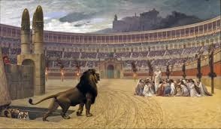
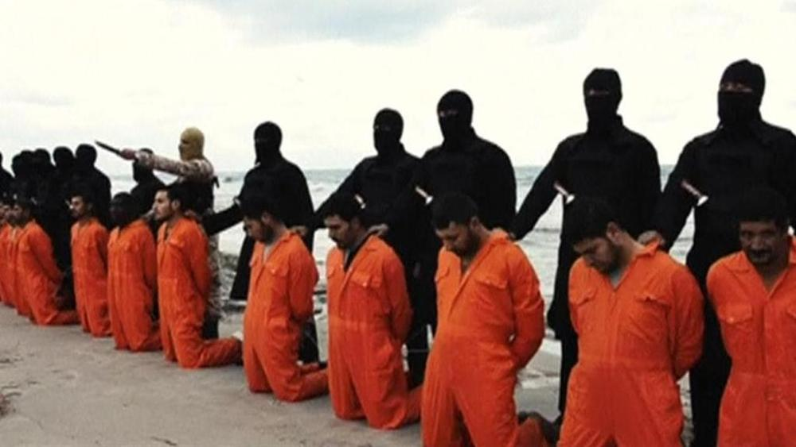
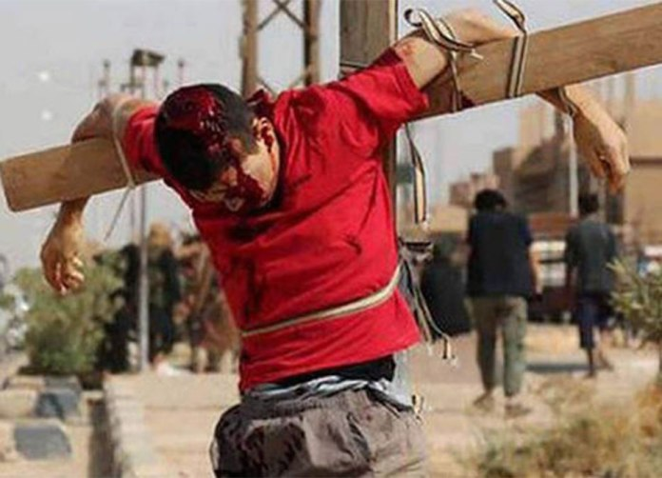
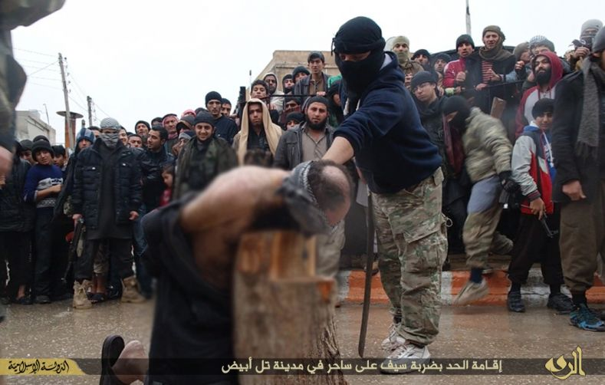

Slide 8
3 choices:
Renounce Jesus and become a Muslim
Continue to be faithful to Jesus and be killed
Sometimes a 3rd option (Dhimmitude) – 2nd class citizen
(Pay higher taxes; Less rights; Sometimes slave-like)
The Open Doors Watch List – 10 worst countries for Christian persecution
North Korea
Afghanistan
Somalia
Libya
Pakistan
Sudan
Eritrea
Yemen
Iran
India
27. China
1/9 Christians in the world, are suffering persecution

Slide 9
Being an “overcomer” – remaining faithful to Jesus
Much of the New Testament is written to encourage persecuted Christians
continue following Jesus
endure
remain faithful
overcome / conquer
Keep the commandments of God & hold to the testimony of Jesus
But how can we be sure that we will remaining faithful to Jesus
The disciples all promised their loyalty, but they failed
“You will all fall away, for it is written, ‘I will strike the shepherd, and the sheep will be scattered.’ ²⁸ But after I am raised up, I will go before you to Galilee.”
²⁹ Peter said to him, “Even though they all fall away, I will not.” ³⁰ And Jesus said to him, “Truly, I tell you, this very night, before the rooster crows twice, you will deny me three times.” ³¹ But he said emphatically, “If I must die with you, I will not deny you.” And they all said the same.

Slide 10
Being an “overcomer” – remaining faithful to Jesus
Much of the New Testament is written to encourage persecuted Christians
remain faithful
overcome / conquer
continue following Jesus
endure
Keep the commandments of God & hold to the testimony of Jesus
But how can we be sure that we will remaining faithful to Jesus
The disciples all promised their loyalty, but they failed
⁵⁰ And they all left him and fled.
The Spirit was willing, but the flesh was weak
They hadn’t yet been filled with the Holy Spirit
⁸ But you will receive power when the Holy Spirit has come upon you, and you will be my witnesses in Jerusalem and in all Judea and Samaria, and to the end of the earth.”
Holy Spirit will never deny Jesus. Neither will those who are filled by Him

Slide 11
^{Mark 13:9} “But be on your guard. For they will deliver you over to councils, and you will be beaten in synagogues, and you will stand before governors and kings for my sake, to bear witness before them. ¹⁰ And the gospel must first be proclaimed to all nations. ¹¹ And when they bring you to trial and deliver you over, do not be anxious beforehand what you are to say, but say whatever is given you in that hour, for it is not you who speak, but the Holy Spirit.
¹² And brother will deliver brother over to death, and the father his child, and children will rise against parents and have them put to death. ¹³ And you will be hated by all for my name’s sake. But the one who endures to the end will be saved.

Slide 12
Being an “overcomer” – remaining faithful to Jesus
Much of the New Testament is written to encourage persecuted Christians
remain faithful
overcome / conquer
continue following Jesus
endure
Keep the commandments of God & hold to the testimony of Jesus
But how can we be sure that we will remaining faithful to Jesus
The disciples all promised their loyalty, but they failed
⁵⁰ And they all left him and fled.
The Spirit was willing, but the flesh was weak
They hadn’t yet been filled with the Holy Spirit
⁸ But you will receive power when the Holy Spirit has come upon you, and you will be my witnesses in Jerusalem and in all Judea and Samaria, and to the end of the earth.”
Holy Spirit will never deny Jesus. Neither will those who are filled by Him
Holy Spirit gives us strength to be His witnesses & endure to the end
“Remaining faithful” isn’t ‘wishful thinking’. It’s a certainty in Christ.

